Slide 1

Customer Segmentation phase 3

Slide 2
3.1 Dataset and it’s detail explanation
The content of an E-commerce database that lists purchases made by 4000 customers over a period of one year (from 2010/12/01 to 2011/12/09). Based on this analysis, I develop a model that allows to anticipate the purchases that will be made by a new customer, during the following year and this, from its first purchase.
Here is the CSV file link to download
https://www.kaggle.com/datasets/akram24/mall-customers

Slide 3
3.2 Building the project
1. Data Preparation 2. Exploring the content of variables 2.1 Countries 2.2 Customers and products 2.2.1 Cancelling orders 2.2.2 StockCode 2.2.3 Basket price 3. Insight on product categories 3.1 Product description 3.2 Defining product categories 3.2.1 Data encoding 3.2.2 Clusters of products 3.2.3 Characterizing the content of clustering

Slide 4
Customer categories 4.1 Formating data 4.1.1 Grouping products 4.1.2 Time spliting of the dataset 4.1.3 Grouping orders 4.2 Creating customer categories 4.2.1 Data enconding 4.2.2 Creating categories 5. Classifying customers 5.1 Support Vector Machine Classifier (SVC) 5.1.1 Confusion matrix 5.1.2 Leraning curves 5.2 Logistic regression 5.3 k-Nearest Neighbors 5.4 Decision Tree 5.5 Random Forest

Slide 5
5.6 AdaBoost 5.7 Gradient Boosting Classifier 5.8 Let’s vote ! 6. Testing the predictions 7. Conclusion

Slide 6
3.3 Preprocess the Dataset
As a first step, I load all the modules that will be used in this notebook:
Import pandas as pd import numpy as np import matplotlib as mpl import matplotlib.pyplot as plt import seaborn as sns import datetime, nltk, warnings import matplotlib.cm as cm import itertools from pathlib import Path from sklearn.preprocessing import StandardScaler from sklearn.cluster import Kmeans from sklearn.metrics import silhouette_samples, silhouette_score from sklearn import preprocessing, model_selection, metrics, feature_selection

Slide 7
From sklearn.model_selection import GridSearchCV, learning_curve from sklearn.svm import SVC from sklearn.metrics import confusion_matrix from sklearn import neighbors, linear_model, svm, tree, ensemble from wordcloud import WordCloud, STOPWORDS from sklearn.ensemble import AdaBoostClassifier from sklearn.decomposition import PCA from Ipython.display import display, HTML import plotly.graph_objs as go from plotly.offline import init_notebook_mode,iplot init_notebook_mode(connected=True) warnings.filterwarnings(“ignore”) plt.rcParams[“patch.force_edgecolor”] = True plt.style.use(‘fivethirtyeight’) mpl.rc(‘patch’, edgecolor = ‘dimgray’, linewidth=1) %matplotlib inline

Slide 8
Then, I load the data. Once done, I also give some basic informations on the content of the dataframe: the type of the various variables, the number of null values and their percentage with respect to the total number of entries:

Slide 9
__________________ # read the datafile df_initial = pd.read_csv(‘../input/data.csv’,encoding=“ISO-8859-1”, dtype={‘CustomerID’: str,’InvoiceID’: str}) print(‘Dataframe dimensions:’, df_initial.shape) #______ df_initial[‘InvoiceDate’] = pd.to_datetime(df_initial[‘InvoiceDate’]) #____________________________________________________________ # gives some infos on columns types and numer of null values tab_info=pd.DataFrame(df_initial.dtypes).T.rename(index={0:’column type’}) tab_info=tab_info.append(pd.DataFrame(df_initial.isnull().sum()).T.rename(index={0:’null values (nb)’})) tab_info=tab_info.append(pd.DataFrame(df_initial.isnull().sum()/df_initial.shape[0]*100).T. Rename(index={0:’null values (%)’})) display(tab_info) #__________________ # show first lines display(df_initial[:5])

Slide 10
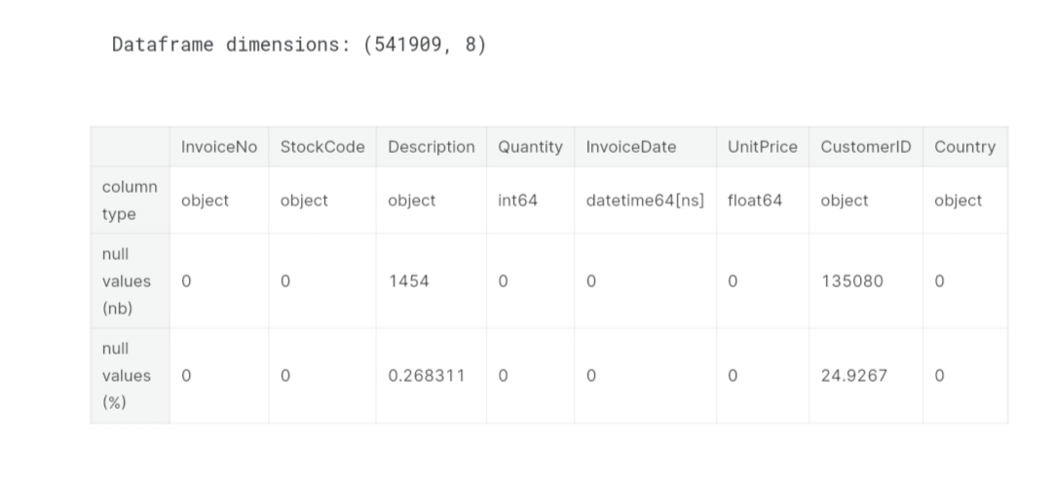

Slide 11
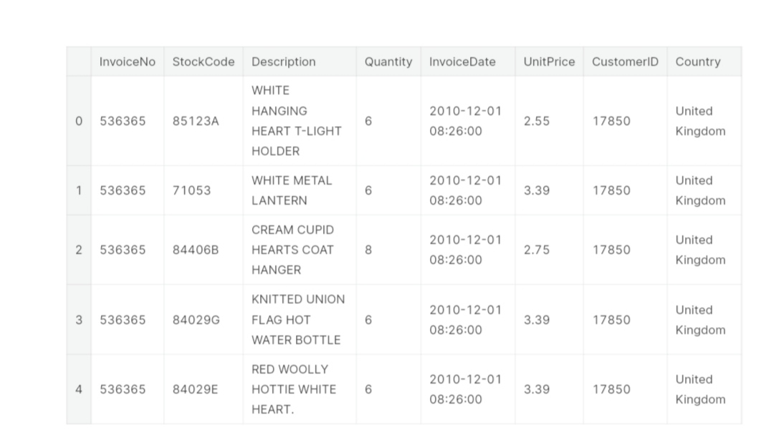

Slide 12
While looking at the number of null values in the dataframe, it is interesting to note that ∼ 25% of the entries are not assigned to a particular customer. With the data available, it is impossible to impute values for the user and these entries are thus useless for the current exercise. So I delete them from the dataframe:

Slide 13
Df_initial.dropna(axis = 0, subset = [‘CustomerID’], inplace = True) print(‘Dataframe dimensions:’, df_initial.shape) #____________________________________________________________ # gives some infos on columns types and numer of null values tab_info=pd.DataFrame(df_initial.dtypes).T.rename(index={0:’column type’}) tab_info=tab_info.append(pd.DataFrame(df_initial.isnull().sum()).T.rename(index={0:’null values (nb)’})) tab_info=tab_info.append(pd.DataFrame(df_initial.isnull().sum()/df_initial.shape[0]*100).T. Rename(index={0:’null values (%)’})) display(tab_info)

Slide 14
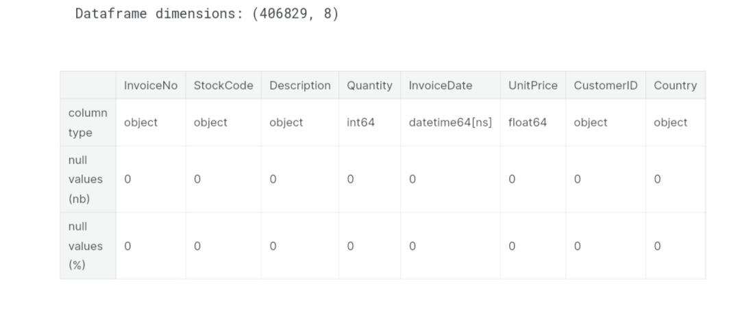

Slide 15
3.4 Different kind of analysis
Countries Here, I quickly look at the countries from which orders were made: Nb. De pays dans le dataframe: 37 and show the result on a chloropleth map:

Slide 16
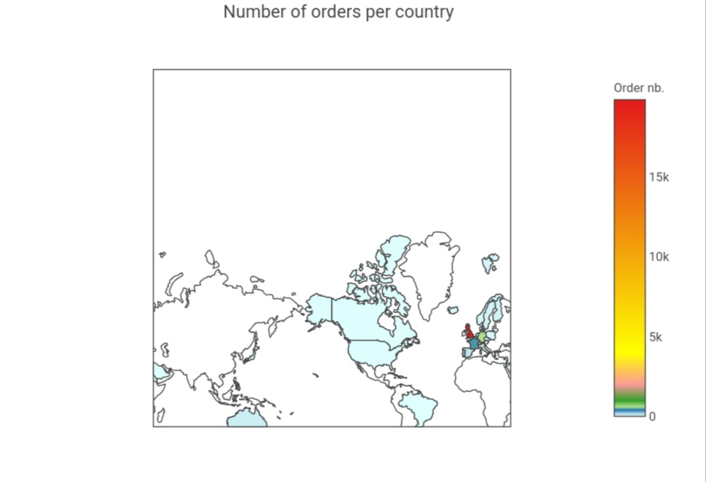

Slide 17
Customers and products The dataframe contains ∼ 400,000 entries. What are the number of users and products in these entries

Slide 18
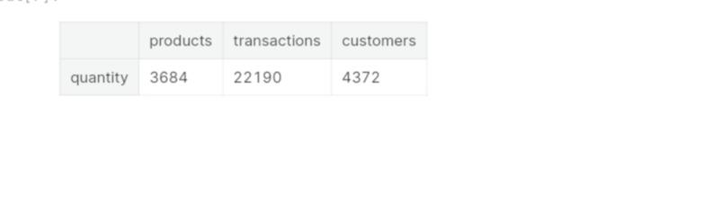

Slide 19
It can be seen that the data concern 4372 users and that they bought 3684 different products. The total number of transactions carried out is of the order of ∼ 22’000. Now I will determine the number of products purchased in every transaction:

Slide 20
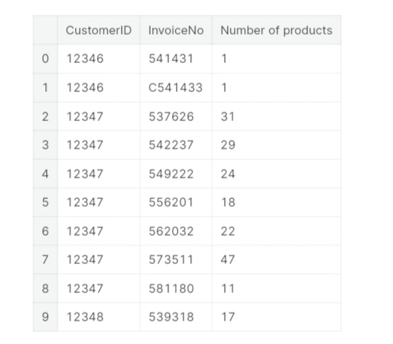

Slide 21
The first lines of this list shows several things worthy of interest: the existence of entries with the prefix C for the InvoiceNo variable: this indicates transactions that have been canceled the existence of users who only came once and only purchased one product (e.g. Nº12346) the existence of frequent users that buy a large number of items at each order

Slide 22
THANK YOU.

